Slide 1
Title
Back
Form
Cancel
Save
Done
Done
Done
Back
Back
Back
Menu
Menu
Menu
Search...

Slide 2
Tab A
Tab B
Tab C
This is a simple connected tab that sets
the on tab to the content clock to visually
connect them and is best for grouping
content inside a panel or page.
Tab A
Tab B
Tab C
This disconnected tab style is good for
cases where tab controls the whole
screen or panel, like in the case of a
toolbar.

Slide 3
      Accordion A
This is an example of an accordion widget
that is used pretty much everywhere on
the web.
      Accordion B
      Accordion C
      Accordion D

Slide 4
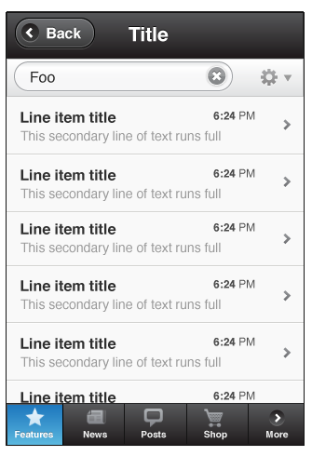
Title
Back
Foo
Line item title
This secondary line of text runs full
6:24 PM
Line item title
This secondary line of text runs full
6:24 PM
Line item title
This secondary line of text runs full
6:24 PM
Line item title
This secondary line of text runs full
6:24 PM
Line item title
This secondary line of text runs full
6:24 PM
Line item title
This secondary line of text runs full
6:24 PM
Features
News
Posts
Shop
More

Slide 5

Simple list item, selected
Simple list item, checked
Simple, drilldown
Simple, optional drilldown
Advanced, drilldown
Clicking the row drills to a new view
6:24 PM
Simple, optional drilldownl
Clicking row selects, blue arrow drills
6:24 PM
Thumbnail

Slide 6

Thumbnail, drilldown
Thumbnail, optional drill
Adv. Thumbnail
Each has a 60px image
6:24 PM
Adv. Thumbnail
Each has a 60px image
6:24 PM
Sortable list
Grouping July 15, 2010
3
List Divider

Slide 7
Form
Back
Save
      Photos
  TOGGLE ON
  On
  TOGGLE OFF
        Off
  SLIDER
  3 seconds
  SEGMENTED
  Off
Low
    High
  DRILL MENU
  3D Cube Flip Flip
  POPUP MENU
  After 5 minutes
  INPUT
  John’s Slideshow

Slide 8
  DATEPICKER
  July 15, 2010
  SPINNER
10:30
AM
  INPUT
  No need to round
  these too much or
  it takes away a lot
  of space for typing.
  RADIO
Radio button A
Radio button B
  CHECKBOX
Checkbox A
Checkbox B

Slide 9
  EMBEDDED DATE PICKER
July 2010
1
2
3
4
5
6
7
8
9
10
11
12
13
14
15
16
17
18
19
20
21
22
23
24
25
26
27
28
29
30
31

Slide 10

  PROGRESS BAR 64% Complete
  INDETERMINATE PROGRESS BAR
      Albums
12
      Events
7
      Tags

Slide 11
  Never
  After 5 minutes
  After 15 minutes
  On device key lock
  Delete This Message?
  Once deleted, a message can
  be recovered from the Trash.
Delete Message
Cancel

